Slide 1
Lecture 4
Ferns and Gymnosperms

Slide 2
Vascular land plants – division Tracheophyta
The vascular plants are embryophytes, which is a large clade or related group, consisting of both non-vascular and vascular plants. The embryophytes are further broken down into the Bryophytes including mosses, liverworts, and non-vascular plants, and Tracheophyta. The term tracheophyte refers to the vascular tissue in vascular plants.
The tracheophytes are further divided into divisions. The divisions are distinguished mostly on how their spores and gametophytes function. In ferns and club-mosses, the gametophyte becomes a free-living generation.
In gymnosperms (conifers) and angiosperms (flowering plants), the gametophyte is dependent on the sporophyte. The gametes developed within become a seed, forming the next sporophyte generation. While every vascular plant shows an alternation of generations with a dominant sporophyte, they differ on how they go about distributing spores and seeds.

Slide 3
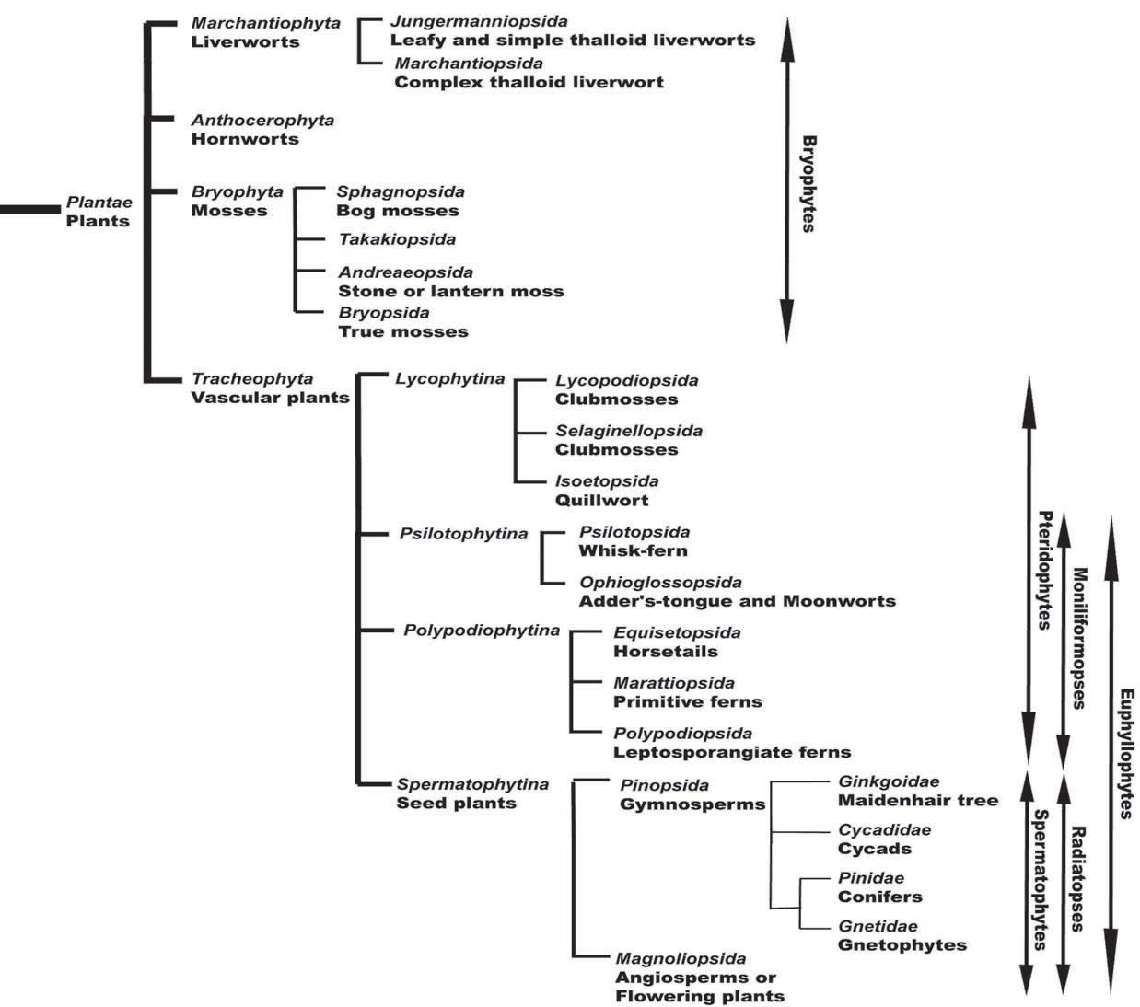

Slide 4
Ferns, club mosses, horsetails, and whisk ferns are seedless vascular plants that reproduce with spores and are found in moist environments. Water is required for fertilization of seedless vascular plants; most favor a moist environment.
CLASSIFICATION OF THE PTERIDOPHYTES
Phylum Pteridophyta
Class Lycopodiopsida
Order Lycopodiales, the club mosses and ground pines, approximately 400 species
Order Selaginellales, the spike mosses, approximately 450 species
Order Isoetales, the quillworts, approximately 130 species
Class Equisetopsida, the horsetails or scouring rushes, 15 species
Class Psilotopsida, the wisk ferns, approximately 12 species
Class Polypodiopsida (Ferns), the true ferns, approximately 10,000 species

Slide 5
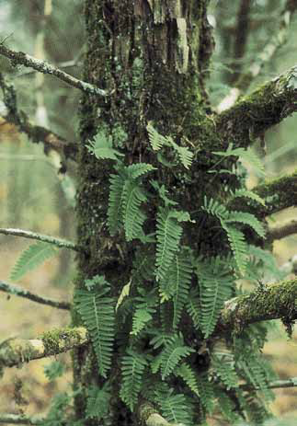
Ferns have been relatively abundant in the fossil record from the Carboniferous period to the present. There are more than 12,000 living species of ferns, the largest and most diverse group of plants other than the angiosperms. It appears likely that the differentiation of modern ferns took place
The diversity of ferns is greatest in the tropics, where about three-fourths of the species are found. Here, not only are there many species of ferns, but ferns are abundant in many plant communities. Approximately a third of all species of tropical ferns grow on the trunks or branches of trees as epiphytes (Fig.).
Fig. - Pleopeltis polypodioides, growing as an epiphyte on a juniper trunk in Arkansas

Slide 6
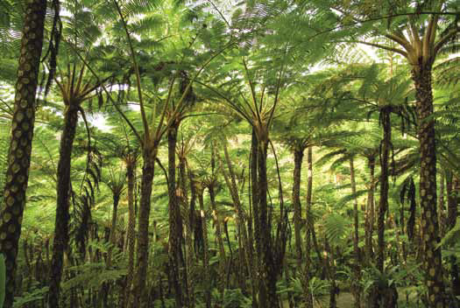
Some ferns are very small and have undivided leaves. Some tree ferns, such as those of the genus Cyathea (Fig.), have been recorded to reach heights of more than 24 meters and to have leaves 5 meters or more in length.
Fig. - A jungle of tree ferns, Cyathea lepifera, in Japan
Although the trunks of such tree ferns may be 30 centimeters or more thick, their tissues are entirely primary in origin. Most of this thickness is the fibrous root mantle; the true stem is only 4 to 6 centimeters in diameter. The herbaceous genus Botrychium has long been cited as the only living fern known to form a vascular cambium, but the presence of a vascular cambium in Botrychium has recently been questioned.

Slide 7
There Are Two Kinds of Sporangia within the Ferns In terms of the structure and method of development of their sporangia, ferns may be classified as either eusporangiate or leptosporangiate (Fig.1,2).
The distinction between these two types of sporangia is important for understanding relationships among vascular plants.
Most living ferns are homosporous, producing only one kind of spore. Heterospory, with both microspores and megaspores produced, is restricted to the water ferns. A few extinct ferns also were heterosporous.

Slide 8
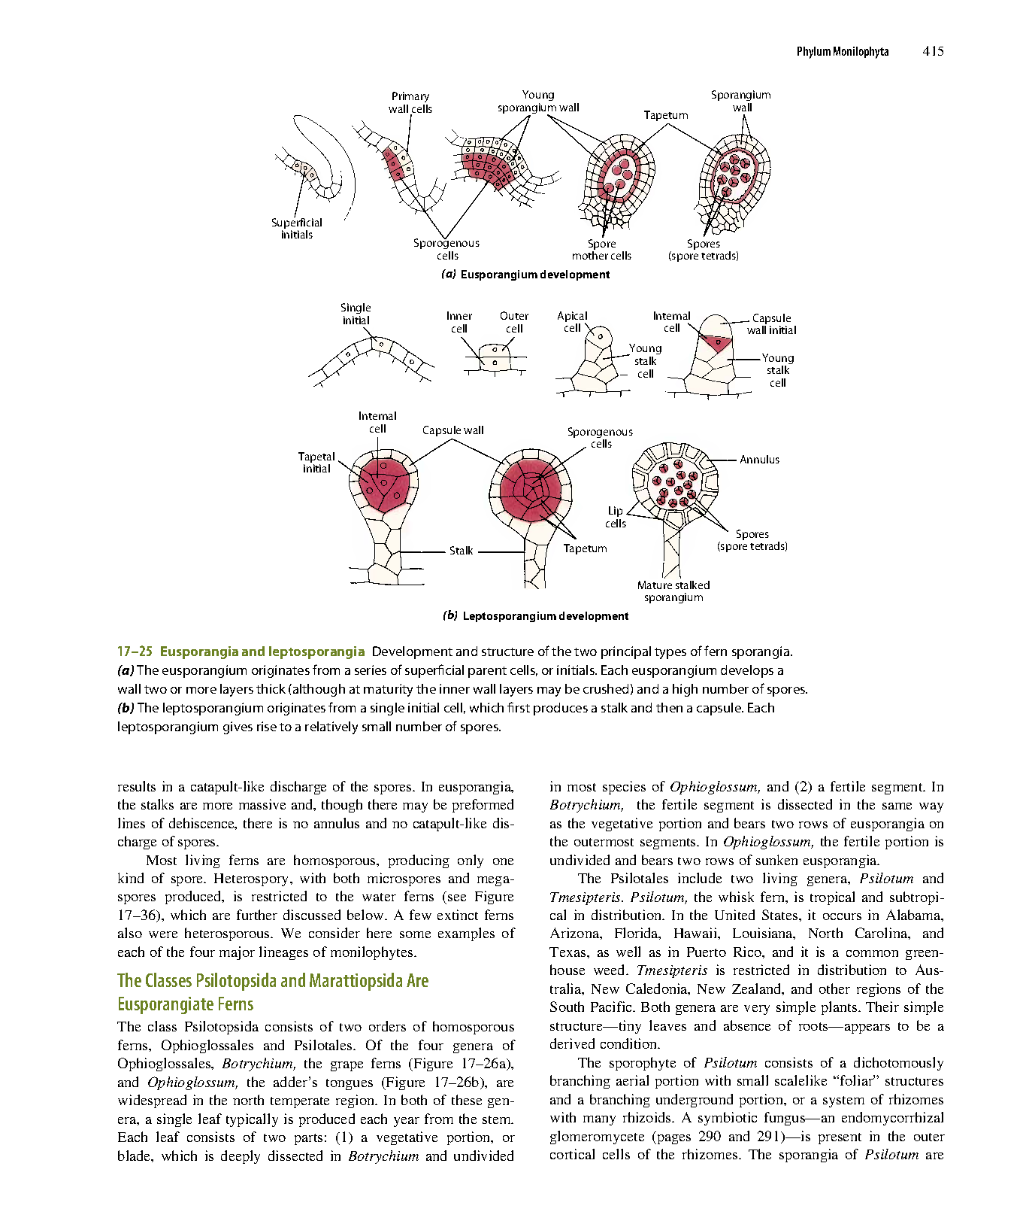
In a eusporangium, the parent cells, or initials, are located at the surface of the tissue from which the sporangium is produced (Fig.1).
Fig.1 - Development and structure the eusporangium
These initials divide by the formation of walls parallel to the surface, producing an inner and an outer series of cells. The outer cell layer, by further divisions in both planes, builds up the several layered wall of the sporangium. The inner layer gives rise to a mass of irregularly oriented cells from which the spore mother cells ultimately arise. The innermost wall layer comprises the tapetum, which probably provides nourishment to the developing spores. In many eusporangia, the inner wall layers may apparently consist of a single layer of cells at maturity.
Eusporangia, which are larger than leptosporangia and contain many more spores, are characteristic of all vascular plants—including the lycophytes—except for the leptosporangiate ferns.

Slide 9
In contrast to the multicellular origin of eusporangia, leptosporangia arise from a single superficial initial cell, which divides transversely or obliquely (Fig.2). The inner of the two cells produced by this division may either contribute cells that produce a large part of the
Fig.2 - Development and structure of the leptosporangium
sporangial stalk or, more commonly, remain inactive.
The outer cell ultimately gives rise to an elaborate, stalked sporangium, with a spherical capsule having a wall that is one cell thick. Within this wall is the two-layered tapetum characteristic of leptosporangia. The inner mass of the leptosporangium eventually differentiates into spore mother cells, which undergo meiosis to produce four spores each.

Slide 10
So true ferns have unique sporangia: leptosporangia, which originate from a single cell in a leaf. They have long, thin stalks, and the wall of one cell layer; they also open actively: when sporangium ripens (dries), the row of cells with thickened walls (annulus) will shrink slower than surrounding cells and finally would break and release all spores at once.

Slide 11
We consider here some examples of each of the four major lineages of monilophytes.
The Classes Psilotopsida and Marattiopsida (Eusporangiate Ferns)
The class Psilotopsida consists of two orders of homosporous ferns, Ophioglossales and Psilotales. Of the four genera of Ophioglossales, Botrychium, the grape ferns (Fig.4), and Ophioglossum, the adder’s tongues (Fig.5), are widespread in the north temperate region. In both of these genera, a single leaf typically is produced each year from the stem.
Each leaf consists of two parts: (1) a vegetative portion, or blade, which is deeply dissected in Botrychium and undivided in most species of Ophioglossum, and (2) a fertile segment.

Slide 12
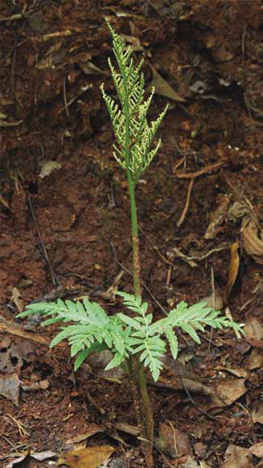
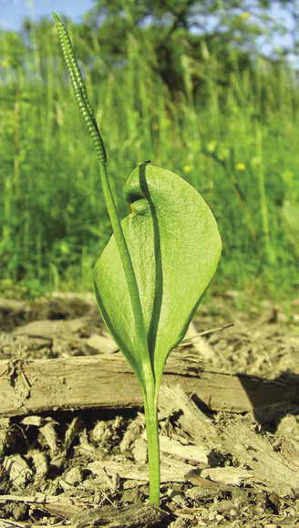
In Botrychium, the fertile segment is dissected in the same way as the vegetative portion and bears two rows of eusporangia on the outermost segments.
In Ophioglossum, the fertile portion is undivided and bears two rows of sunken eusporangia.
Fig.3 - Botrychium dissectum.
Fig.4 - Ophioglossum
vulgatum
In both genera, the erect, fertile, upper part of the leaf is sharply distinct from the vegetative portion.

Slide 13
The Psilotales include two living genera, Psilotum and Tmesipteris. Psilotum, the whisk fern, is tropical and subtropical in distribution. Tmesipteris is restricted in distribution to Australia, New Caledonia, and other regions of the South Pacific. Both genera are very simple plants. Their simple structure—tiny leaves and absence of roots—appears to be a derived condition.
The sporophyte of Psilotum consists of a dichotomously branching aerial portion with small scalelike “foliar” structures and a branching underground portion, or a system of rhizomes with many rhizoids. A symbiotic fungus—an endomycorrhizal glomeromycete—is present in the outer cortical cells of the rhizomes. The sporangia of Psilotum are generally aggregated in groups of three on the ends of short, lateral branches (Fig.6).

Slide 14
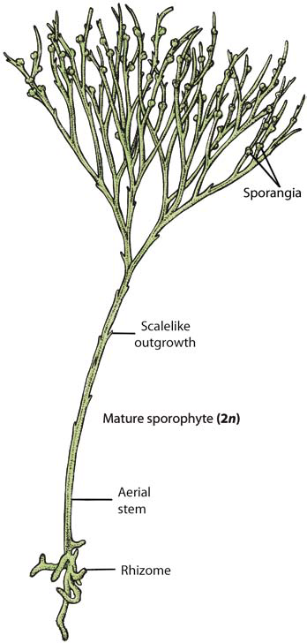
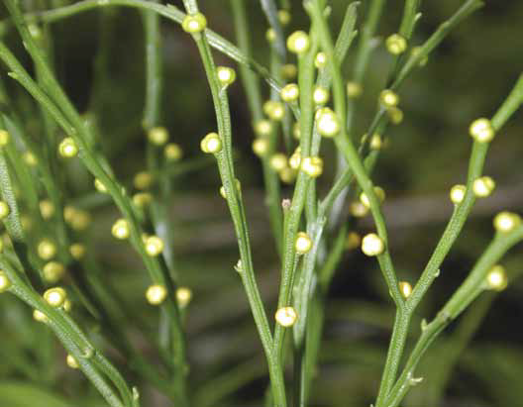
(a) In Psilotum,
the sporophyte consists of a dichotomously branching aerial portion, with small scalelike outgrowths, and a system of rhizomes. Sporangia are borne in
united groups of three in the axils of some scalelike outgrowths.
(b) The dichotomously branching aerial portion of the sporophyte with numerous yellow sporangia.
b
a
Fig. 6 - Psilotum nudum Sporophyte

Slide 15
Tmesipteris grows as an epiphyte on tree ferns and other plants (Fig.7) and in rock crevices. The leaves of Tmesipteris, which are larger than the scalelike structures of Psilotum, are supplied with a single, unbranched vascular bundle. In other respects Tmesipteris is essentially similar to Psilotum.
The gametophytes of Botrychium, Ophioglossum, and Psilotum (Fig.8) are subterranean, tuberous, elongated structures with numerous rhizoids; they contain symbiotic fungi. Some Psilotum gametophytes contain vascular tissue. The gametophytes are bisexual, bearing both antheridia and archegonia.
The sperm are multiflagellated and require water to swim to the eggs. In the nature of their gametophytes, the structure of their leaves, and several other anatomical details, the Ophioglossales are sharply distinct from other living ferns and are clearly an early diverging and distinct group.

Slide 16
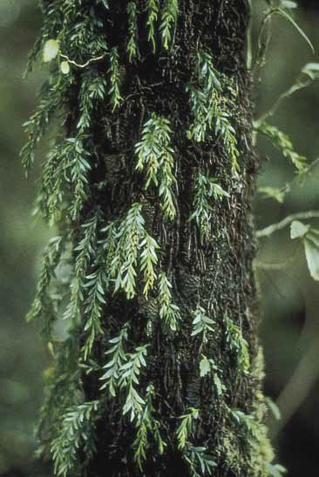
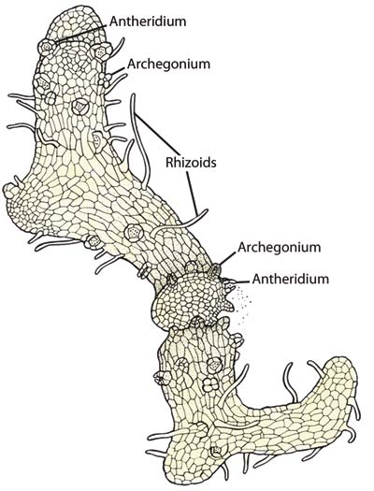
Fig. 7 - Tmesipteris parva is seen here growing on the trunk of the tree fern Cyathea australis in New South Wales, Australia.
.
Fig. 8 - Psilotum nudum gametophyte
The Psilotum gametophyte is bisexual, bearing both antheridia and archegonia.

Slide 17
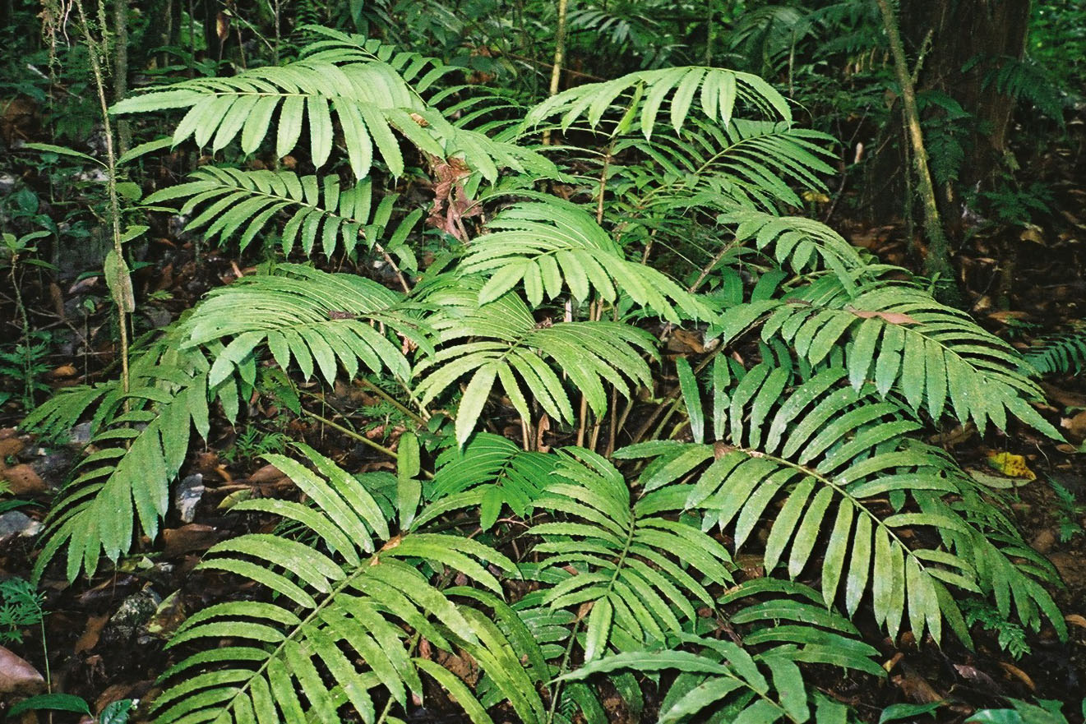
The only other group of eusporangiate ferns, the tropical Marattiopsida, is an ancient group with a fossil record that extends back to the Carboniferous period.
Marattioid Ferns
The members of this order resemble more familiar groups of ferns more closely than they resemble Ophioglossales. The six living genera of Marattiales include about 200 species.

Slide 18
Class Polypodiopsida
Most Polypodiopsida Are Homosporous Leptosporangiate Ferns. Nearly all familiar ferns are members of the class Polypodiopsida, with at least 10,500 species. About 35 families and 320 genera are recognized in the class.
Polypodiopsida differ from Psilotopsida and Marattiopsida in being leptosporangiate; they differ from the water ferns, in being homosporous. All ferns other than Psilotopsida and Marattiopsida, in fact, are leptosporangiate, and very few have the subterranean gametophytes with symbiotic fungi that are characteristic of the Psilotopsida and Marattiopsida.

Slide 19
Most garden and woodland ferns of temperate regions have rhizomes that produce new sets of leaves each year. The fern embryo produces a true root, but this soon withers, and the rest of the roots arise from the rhizomes near the bases of the leaves.
Their leaves are called fronds because of apical growth; are megaphylls, and they represent the most conspicuous part of the sporophyte. Their high surface-to-volume ratio allows them to capture sunlight much more effectively than the microphylls of the lycophytes. The ferns are the only seedless vascular plants to possess well-developed megaphylls.

Slide 20
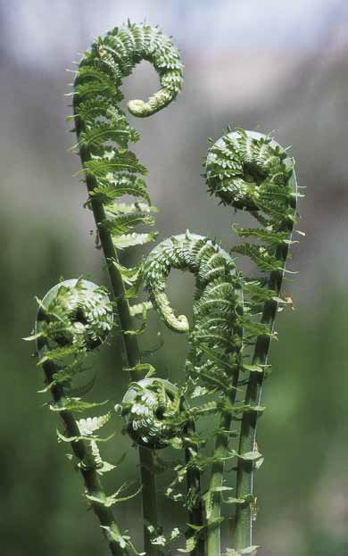
Commonly, the fronds are compound; that is, the lamina is divided into leaflets, or pinnae, which are attached to the rachis, an extension of the leaf stalk, or petiole. In nearly all ferns, the young leaves are coiled (circinate); they are commonly referred to as “fiddleheads” (Fig.).
Fig. - Fiddleheads Ostrich fern (Matteuccia struthiopteris)

Slide 21
This type of leaf development is known as circinate vernation. Uncoiling of the fiddlehead results from more rapid growth on the inner than on the outer surface of the leaf early in development. This type of vernation protects the delicate embryonic leaf tip during development.
Both fiddleheads and rhizomes are usually clothed with either hairs or scales, both of which are epidermal outgrowths; the characteristics of these structures are important in fern classification.
The sporangia of Polypodiopsida occur on the margins or lower surfaces of the leaves, on specially modified leaves, or on separate stalks. The sporangia commonly occur in clusters called sori (singular: sorus) (Fig.9), which may appear as yellow, orange, brownish, or blackish lines, dots, or broad patches on the lower surface of a frond.

Slide 22
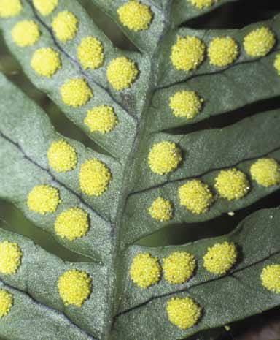
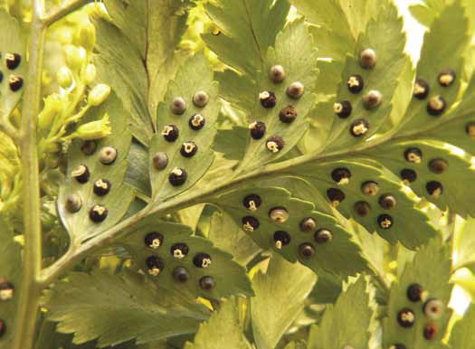
a
b
Fig 9- Sori. Clusters of sporangia, or sori, are found on the undersides or margins of the leaves of ferns.
In Polypodium virginianum and other ferns of this genus, the sori are bare.
In this Polystichum species, the indusia, which completely cover the sori, eventually contract, exposing the sporangia as they near maturity.

Slide 23
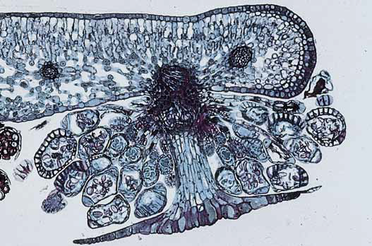
In many genera, the young sori are covered by specialized outgrowths of the leaf, the indusia (singular: indusium; Fig.10), which may shrivel when the sporangia are ripe and ready to shed their spores. The shape of the sorus, its position, and the presence or absence of an indusium are important characteristics in the taxonomy of the Polypodiopsida.
Leaf
Fig.10 - Sorus with an indusium Transverse section of a leaf of
Cyrtomium falcatum, a homosporous fern, showing a sorus on the lower surface. The sporangia are in different stages of development
and are protected by an umbrella-like indusium.
Sporangia
Indusium

Slide 24
The spores of ferns in the class Polypodiopsida give rise to free-living, potentially bisexual gametophytes, which are often found in moist places.
The gametophyte typically develops rapidly into a flat, heart-shaped, usually membranous structure, the prothallus (Fig.11), that has numerous rhizoids on its central lower surface. Both antheridia and archegonia develop on the ventral (lower) surface of the prothallus.
The antheridia more typically occur among the rhizoids, while the archegonia are usually formed near the notch, an indentation at the anterior end of the gametophyte. Water is required for the multiflagellated sperm to swim to the eggs.
Early in its development, the embryo, or young sporophyte, receives nutrients from the gametophyte through a foot. Development is rapid, and the sporophyte soon becomes an independent plant, at which time the gametophyte commonly disintegrates.

Slide 25
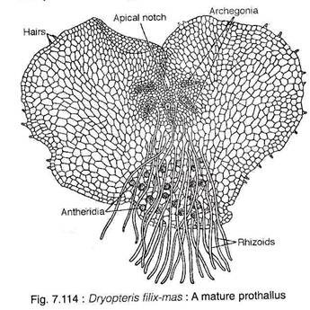
Fig. 11 – Dryopteris filix-mas. A mature prothallus

Slide 26
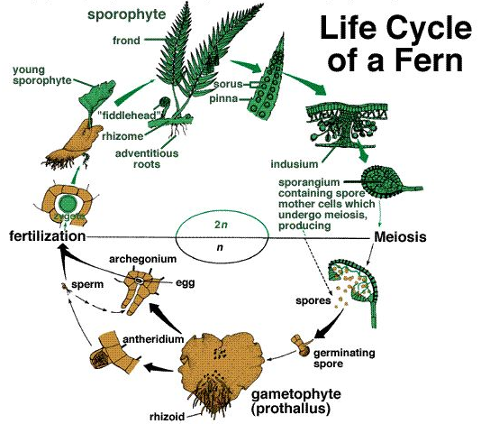

Slide 27
True ferns are highly competitive even to angiosperms. In spite of their “primitive” life cycle, they have multiple advantages: abilities to photosynthesize in deep shade (they are not obliged to grow fast), to survive high humidity, and to make billions of reproductive units (spores). Ferns do not need to spend their resources on flowers and fruits, and are also less vulnerable to vertebrate herbivores and insect pests.

Slide 28
Division Tracheophyta – vascular plants, tracheophytes
Class Polypodiopsida – leptosporangiate ferns
Order Polypodiales
Family Dryopteridaceae – wood ferns, woodferns
Genus Dryopteris Adans. – shieldfern, woodfern,
The genus Dryopteris (Fig.12).
included 250 species that are distributed in tropical, subtropical and north temperate regions of the world. They usually grow in moist, cool and shady places. They are also grown in green houses, gardens and summer houses for beauty of their large sized leaves. Dryopteris is herbaceous, perennial and rhizomatous.
The sporophytic plant body is differentiated into roots, rhizomatous stem and leaves.
The primary root is ephemeral, and is replaced by a large number of adventitious roots growing from the leaf bases. The roots are small and branched.

Slide 29
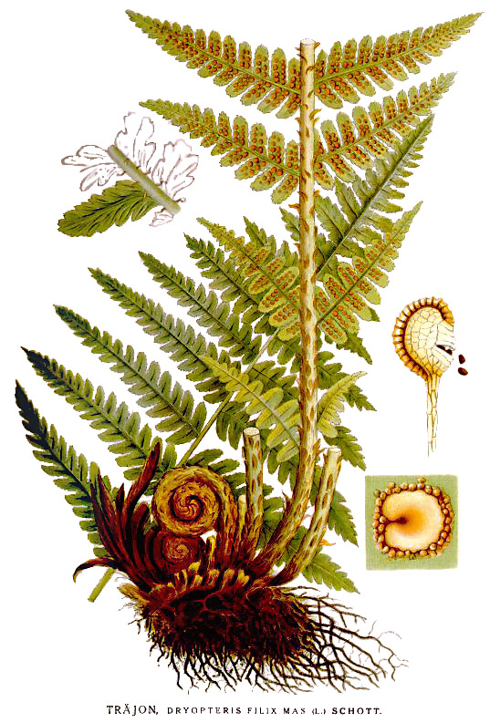
The stem is rhizomatous — partly horizontal and partly erect with the apex rising just above the soil surface. The rhizome is covered with scales and adventitious roots.
The leaves are borne acropetally at the apex of the rhizome. When young, the leaves are spirally coiled and show circinate ptyxis that is typical to true ferns. The leaves (fronds) are unipinnately compound with a long rachis. The leaf bases persist when the older leaves perish. All leaves are fertile, bearing sori on the ventral (abaxial) surface of pinna. The base of the rachis is paleaceous i.e., covered by numerous brown scales called ramenta.
Dryopteris reproduces by means of spores.
Fig.12 – Dryopteris filix mas

Slide 30
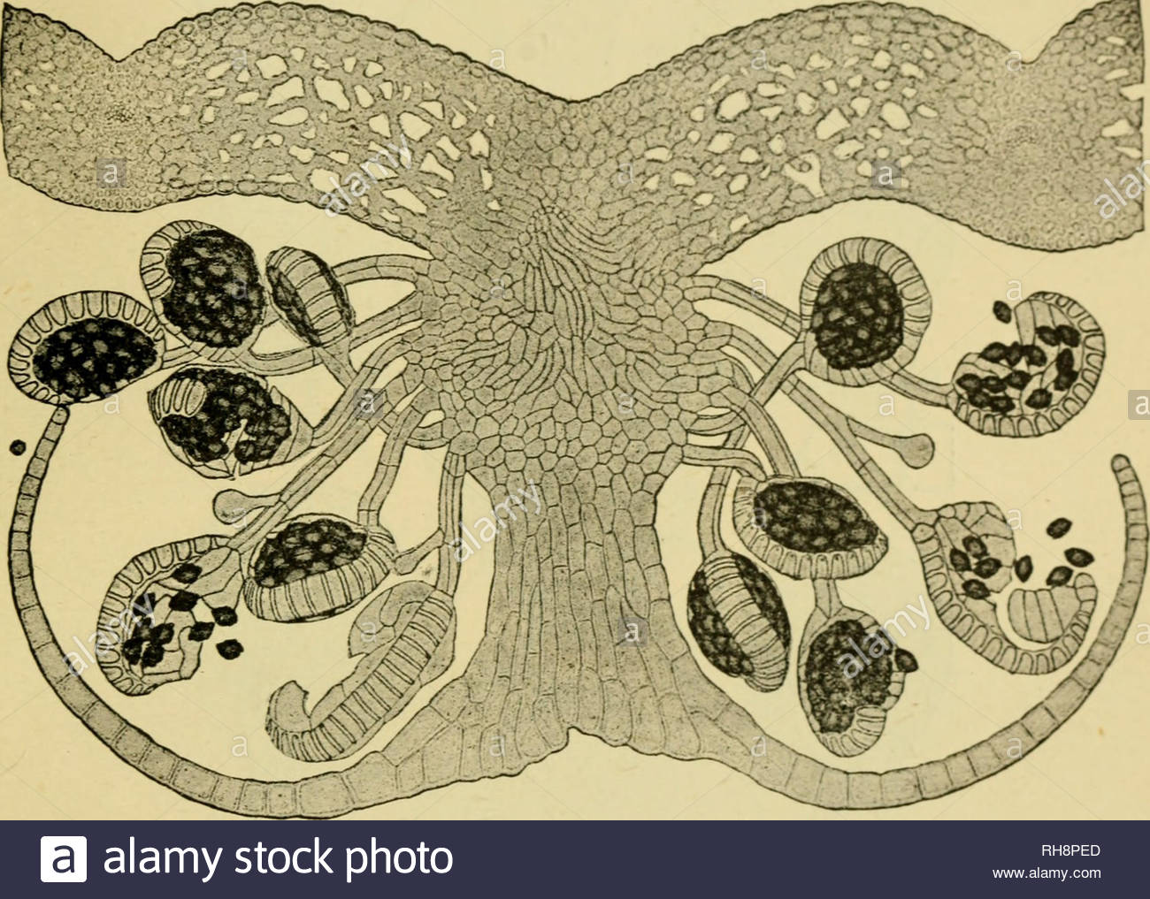
Dryopteris is a homosporous fern. The sori are borne in two rows on two sides of the median vein of a pinnule in-between the margin and the midrib. Each sorus is covered by a kidney-shaped indusium (Fig.13). A number of stalked sporangia arise from the central placental tissue. Sori are of mixed type i.e., sporangia arise without any order of development.
Leaf
Sporangia
Spores
Indusium
Fig.13 - Sorus
Placenta

Slide 31
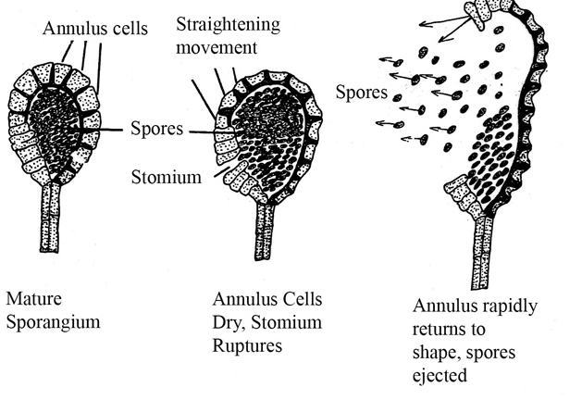
The sporangium of Dryopteris (Fig.14) is comprised of a long stalk and a terminal capsule. The single-layered jacket of the capsule is differentiated into a thick-walled vertical annulus, a thin-walled radially arranged stomium and large parenchymatous cells with undulated walls.
Dryopteris is homosporous, so the capsule contains isospores which are structurally and functionally alike.
The spores are triangular in shape with trilete aperture. The outer spore wall, exine, is either smooth or variously ornamented.
The sporangum dehisces transversely along the stomium due to the shrinkage of annular cells. The spores are dispersed through air to a moderate distance.
Fig.14- Sporangium of Dryopteris

Slide 32
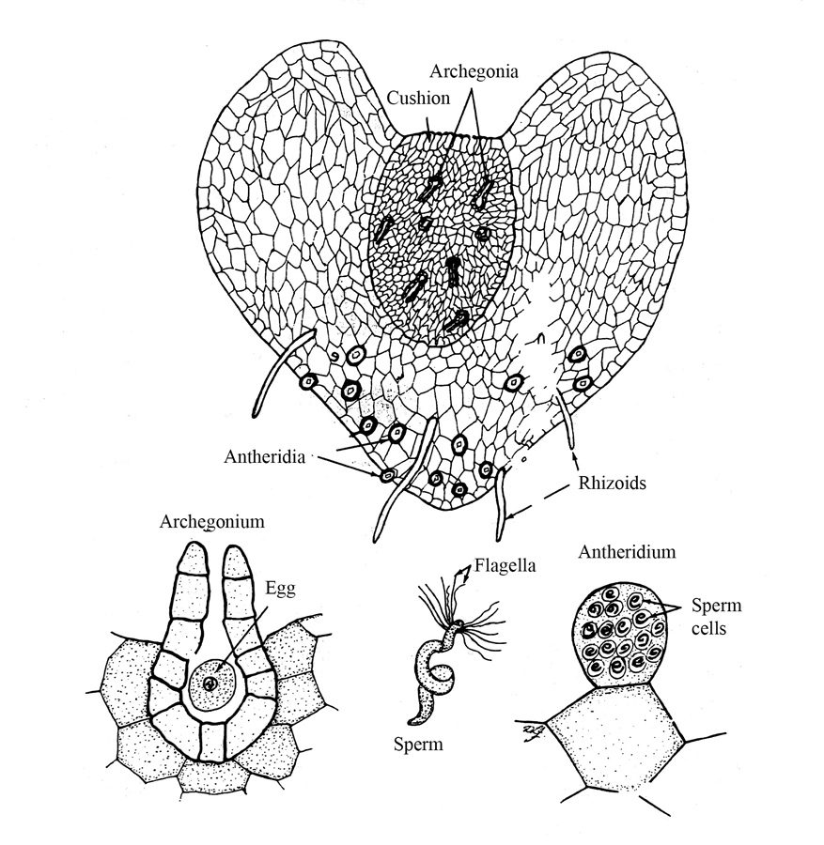
Gametophyte:
A haploid spore is the first cell of sexual or gametophyte generation. Under suitable moist condition, each spore germinates into a gametophyte called prothallus (Fig.15). It is a flat, green, non-vascular heart shaped structure with about 5- 13 mm in diameter. The dorsal surface is smooth while ventral surface contains unicellular rhizoids and sex-organs. Prothallus has a narrow posterior end and a distinct apical notch at anterior end.
The rhizoids arise from the ventral side of the posterior end which helps in anchorage, absorption of water and nutrients from soil. Prothallus is short lived and dies in drought conditions.
Fig.15 - Prothallus

Slide 33
Antheridia appear first and are confined to the basal central regions among the rhizoids. Archegonia develop near the apical notch (Fig.16).
Antheridia (Male Sex organs): They are small, sessile dome shaped and found intermixed with rhizoids. Each antheridium has a sterile 3-celled jacket wall that as closed about 32-48 androcytes. Each androcyte metamorphose into a coiled (2-3), multi-flagellate antherozoid or spermatozoid.
Archegonia (Female Sex organs): They are sessile, flask-shaped and embedded on apical cushion just behind the apical notch. Each archegonium has a swollen venter and a backwardly projected neck.
The venter encloses an egg (oosphere) and a venter canal cell, while the neck contains along, binucleate neck canal cell. In mature archegonium, the neck canal cell and the venter canal cell disintegrates into mucilaginous mass.

Slide 34
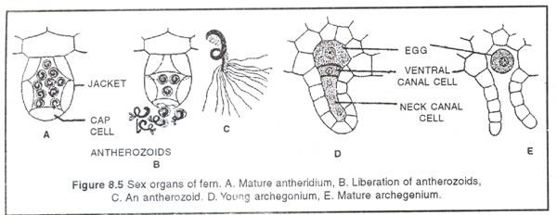
Fig.16 - Sex organ of fern. A. Mature antheridium, B. Liberation of antherozoids, C. An antherozoid, D. Young archegonium, E. Mature archegonium
Fertilization:
When a film of water flow between prothallus and substratum, the cap cells of antheridia pushed open to release antherozoids. The antherozoids swim towards archegonia in response to malic acid released from mucilaginous mass (chemotactic). Many antherozoids swim down the neck of archegonium, only one of them fuses with egg to form a diploid zygote. Usually, cross-fertilization occurs due to protandrous nature of prothalli (i.e. antheridia mature before archegonia).

Slide 35
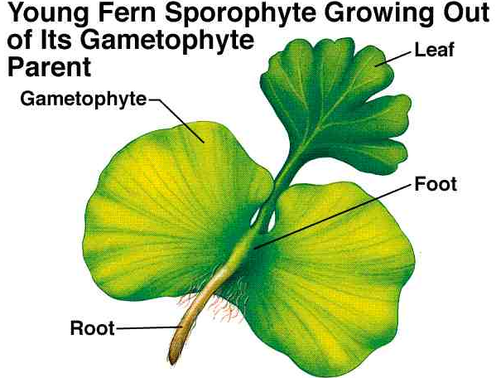
Development of young Sporophyte (Fig.17):
The Zygote (2n) is the first cell of sporophyte generation. The zygote undergoes repeated mitosis to develop embryo. The embryo has 4 district parts i.e. foot, root, astern apex and the first leaf. Foot absorbs water and minerals from young sporophyte. The stem apex grows into a rhizome.
Primary root is short lived and soon replaced by adventitious roots. The first leaf is replaced by pinnately compound leaf. By the time young sporophyte becomes independent, the prothallus dries up and degenerates. Although several archegonia may fertilize in a prothallus, only one sporophyte matures
Shoot
Fig.17 - Young sporophyte

Slide 36
The Water Ferns, of the Class Polypodiopsida
The Water Ferns, of the Class Polypodiopsida, are Heterosporous Leptosporangiate Ferns
The water ferns consist of one order, the Salviniales, and two families, Marsileaceae and Salviniaceae. There are five genera of water ferns. The slender rhizomes of the three genera of Marsileaceae, including Marsilea (which has about 50 to 70 species), grow in mud, on damp soil, or often with the leaves floating on the surface of water (Fig.18a). The leaves of Marsilea resemble those of a four-leaf clover. Drought-resistant, bean-shaped reproductive structures called sporocarps, which may remain viable even after 100 years of dry storage, germinate when placed in water to produce chains of sori, each bearing series of megasporangia and microsporangia (Fig.18b).

Slide 37
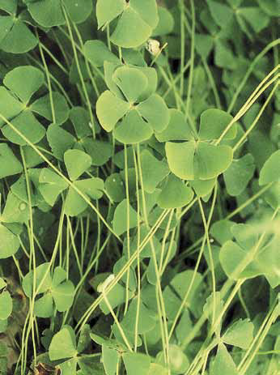
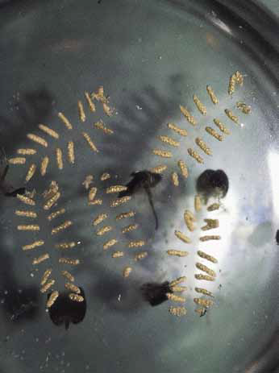
a
b
Fig. 18 - Water ferns
Marsilea polycarpa, with its leaves floating on the surface of the water
Marsilea, showing the germination of a sporocarp, with chains of sori. Each sorus contains a series of megasporangia and microsporangia.

Slide 38
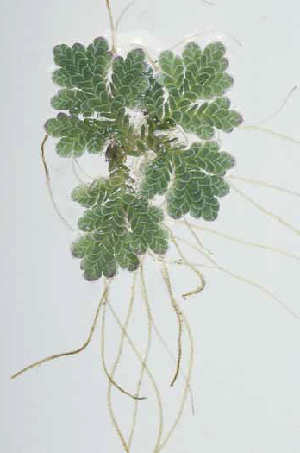
The two genera of Salviniaceae, Azolla (Fig.19) and Salvinia, are small plants that float on the surface of water. Both genera produce their sporangia in sporocarps that are quite different in structure from those of Marsileaceae.
Fig.19 - Azolla

Slide 39
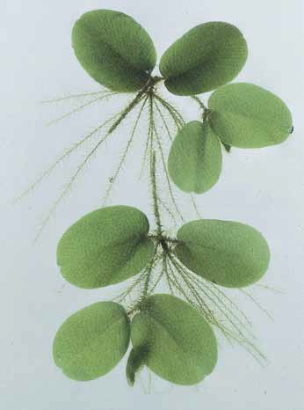
The undivided leaves of Salvinia (Fig.20), which are up to 2 centimeters long, are borne in whorls of three on the floating rhizome. One of the three leaves hangs down below the surface of the water and is highly dissected, resembling a mass of whitish roots. These “roots,” however, bear sporangia, which reveals that they are actually leaves. The two upper leaves, which float on the water, are covered by hairs that protect their surface from getting wet, and the leaves float back to the surface if they are temporarily submerged.
Fig.20 - Salvinia

Slide 40
Gymnosperms
Gymnosperms are seed-bearing vascular plants, such as cycads, ginkgo, yews and conifers, in which the ovules or seeds are not enclosed in an ovary. Gymnosperm seeds develop either on the surface of scale or leaf-like appendages of cones, or at the end of short stalks.
Unlike angiosperms, gymnosperms do not produce flowers or fruit. They are believed to be the first vascular plants to inhabit land appearing in the Triassic Period around 245-208 million years ago. The development of a vascular system capable of transporting water throughout the plant enabled gymnosperm land colonization.

Slide 41
Today, there over one thousand species of gymnosperms belonging to four main divisions:
1. Coniferophyta,
2. Cycadophyta,
3. Ginkgophyta,
4. Gnetophyta.
Some of the most recognizable examples of these woody shrubs and trees include pines, spruces, firs, and ginkgoes. Gymnosperms are abundant in temperate forest and boreal forest biomes with species that can tolerate moist or dry conditions.

Slide 42
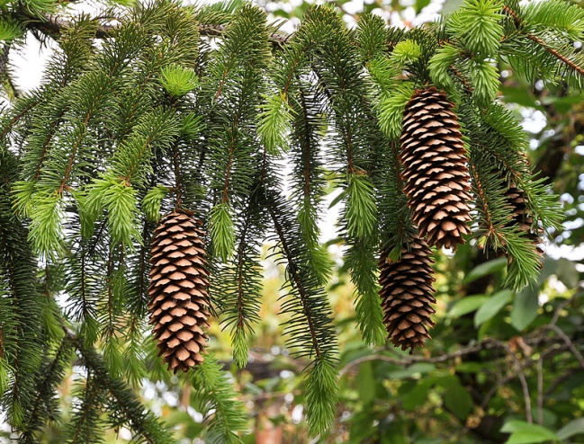
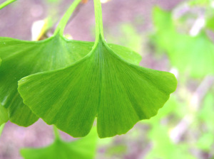
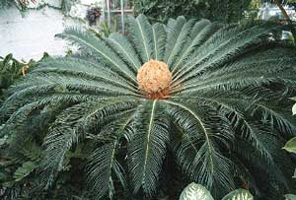
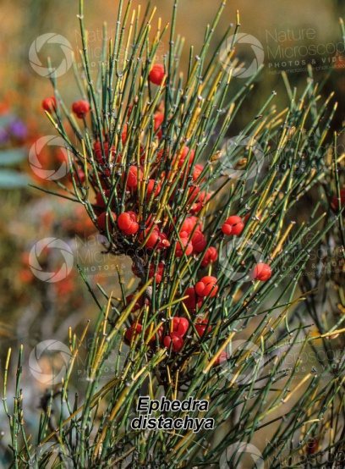

Slide 43
Coniferophyta / Pinophyta
The conifers are assigned to the
  Division: Pinophyta / Coniferophyta
  Class: Pinopsida / Coniferopsida
  Order: Pinales / Coniferales
Termed conifers because most members bear their seeds in cones
  Cones protect ovule and seed and facilitate pollination and dispersal
They are the largest and most ecologically & economically important of the gymnosperms

Slide 44
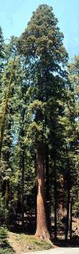
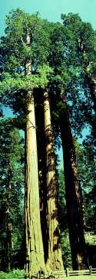
Sequoia sp.
(Redwoods)
Sequoiadendron sp.
(Giant sequioas)

Slide 45
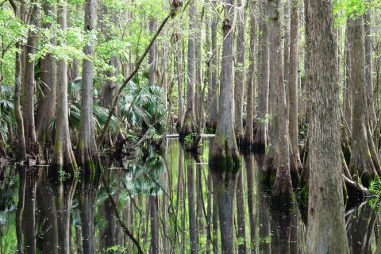
Bald Cypress swamp, Cupressus sp. (Cupressaceae)

Slide 46

Sequoiadendron sp.

Slide 47
Coniferophyta - Families
The conifers constitute 6-7 families, 63 genera & > 600 spp.
  Pinaceae (Pines)
  Cupressaceae (Cypress family)
  Taxaceae (Yew family)
  Cephalotaxaceae
  Podocarpaceae
  Araucariaceae

Slide 48
Family: Coniferaceae/Pinaceae
Strong trees
Emit strong odour from bark &/or leaves
  Resin canals throughout stem & leaves
Branches whorled or opposite
  Consist of long and short shoots
Simple leaves
  Linear / Needle-shaped
  Clustered in fascicles of 2-5 needles
  Sessile or short petioled on long shoots
  Tightly clustered on short shoots
  Persistent (evergreen)

Slide 49
Coniferaceae / Pinaceae
Usually have straight trunks with horizontal branches varying more or less regularly in length from bottom to top, so that the trees are conical in outline
Members are monecious
Reproduce through micro- & megasporangiate (staminate and ovulate) cones
Wood is very hard

Slide 50
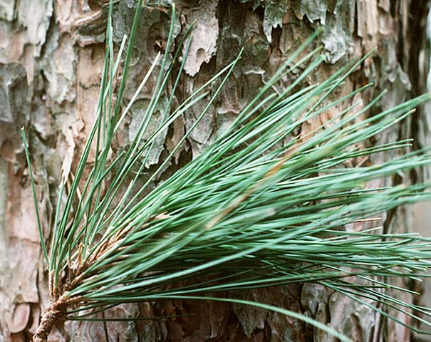
thick
stem
needles
dwarf shoot
branch of unlimited growth/long shoot

Slide 51
Pinaceae - Reproduction
In pine as in other vascular plants, the sporophyte (the spore-producing generation), or pine tree is the dominant generation. The sporophyte bears two types of reproductive structures referred to as “male” and “female” cones.
Each cone is considered to be a modified branch with a number of modified leaves, called scales or sporophylls. Each sporophyll bears a structure called a sporangium in which the spores are produced. Unlike the ferns, in gymnosperms the spores as well as the gametes come in two sizes: separate microspores (produced in microsporangia, and which develop into male gametophytes) and megaspores (produced in megasporangia, and which develop into female gametophytes) — (micro = small; mega = large, great).

Slide 52
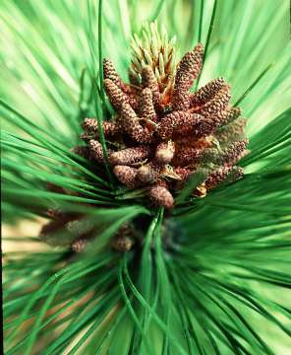
The “male” (staminate) cones typically are found in clusters at the tips of lower, side (lateral) branches, and usually take several years to develop. In these cones, the modified leaves are called microsporophylls (phyll = leaf). Each microsporophyll bears two microsporangia within which the microspores are produced.
Cluster of male cones on apex of
Pinus stem

Slide 53
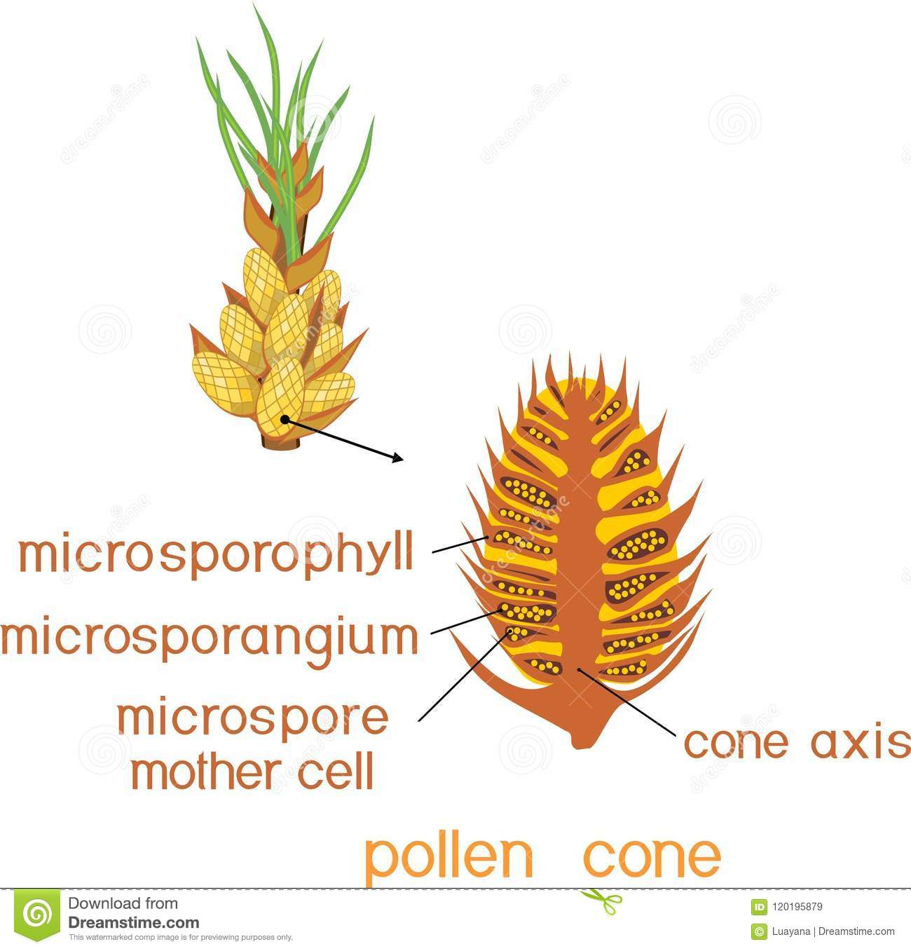
Within the microsporangia, the microspore mother cells undergo meiosis to form four haploid microspores, the start of the male gametophyte generation (the pollen — note, pollen is not the same thing as sperm, rather it is a gametophyte). Still inside the microsporangium, each microspore divides and “grows” to form a four-celled (four nuclei, anyway) male gametophyte, also known as pollen which contains two sperm nuclei. A grain of pine pollen also has two large air sacs to make it buoyant in the wind.

Slide 54
Pinaceae - Reproduction
Each microspore enters a megaspore via pollen tube
Reproduction process slow (takes usually 13 months on average to produce a new sporophyte)

Slide 55
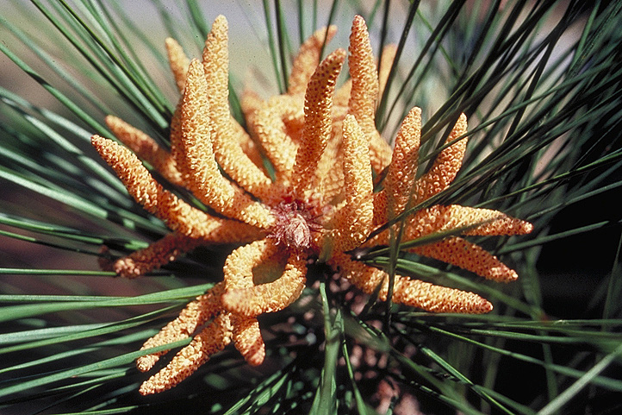
Pollen (male) cones of Pinus taeda

Slide 56
Male Gametophyte
Soon after meiosis, each microspore undergoes two subsequent mitotic divisions to form a four-celled male gametophyte or pollen grain. These four cells include two, small, flat prothallial cells, a large tube cell, and a generative cell (which will form the sperm nuclei).
Pollination is the transfer of the whole male gametophyte to the female plant. In pine, the pollen is blown by wind. Note that this is NOT the equivalent of fertilization — that must still occur later!

Slide 57
Microgamete Development in Conifers
The pollen grains do not immediately start germinating on reaching the nucellus.
In Pinaceae it rests for about a year after the migration of the tube nucleus into the pollen tube (soon after pollination).
It is during the next spring that the generative cell divides into sterile (stalk) cell and spermatogenous (body) cell, which then migrate into the tube.
No motile sperm. Pollen tube delivers sperm nuclei into the archegonium.

Slide 58
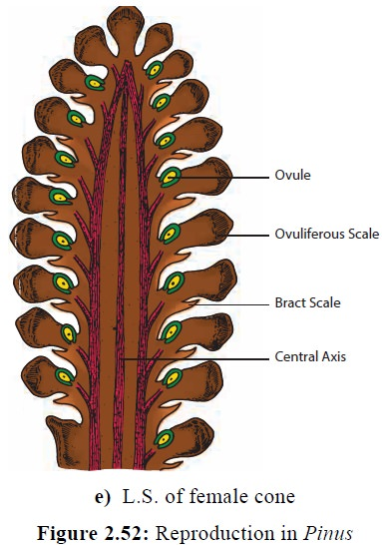
The female cones typically form higher up in the tree, and also usually take several years to develop. These cones consist of a number of scales which many botanists consider to be megasporophylls (leaves) while others consider them to be modified branches. In a slide of a longitudinal section of a young cone, a small bract can often be seen attached to the underside of each scale. On the upper surface of each scale is a side-by-side pair of ovules, only one of which will be visible on the slide.

Slide 59
The central area of the ovule is called the nucellus (the megasporangium) which contains the megaspore mother cell. Surrounding the nucellus is an integument. Near the base of the scale there is a gap in the integument called the micropyle (pyle = gate, orifice) where the pollen grains enter. Each megaspore stays within its megasporangium and goes through several mitotic divisions to become a female gametophyte, which then develops an archegonium with an egg in it.

Slide 60
When a pollen grain passes through the micropyle, we say that pollination has occurred. Then, to accomplish fertilization, once the pollen grain has entered the micropyle, a tube from the pollen (called a pollen tube) “germinates” and grows through the nucellus.
This stimulates the megaspore mother cell to undergo meiosis, producing four megaspores, only one of which in each ovule develops/grows into a female gametophyte. The female gametophyte eventually is multicellular. Most of it is undifferentiated tissue which will be used to store nutrients, but near the micropyle, several archegonia are formed, each containing an egg.

Slide 61
Pinaceae – Reproduction
Megasporangiate/ovulate cones
  Larger than the male cones
  Borne on stem (intercalary)
  Spirally arranged, flattened bract/ovuliferous-scale complex
    Woody (ovuliferous) scale (megasporophyll) envelops the 2 ovules on adaxial surface.
    Papery bract / carpellary scale
    Micropyles of ovules directed toward the axis of the cone
    Few archegonia/ovule
  Derived from modified branch bearing lateral branches (with seeds) borne in the axils of leaves

Slide 62
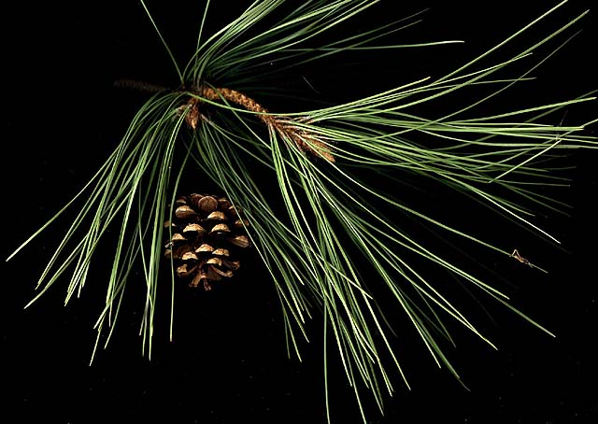
Female (ovulate) cone on branch of Pinus sp.

Slide 63
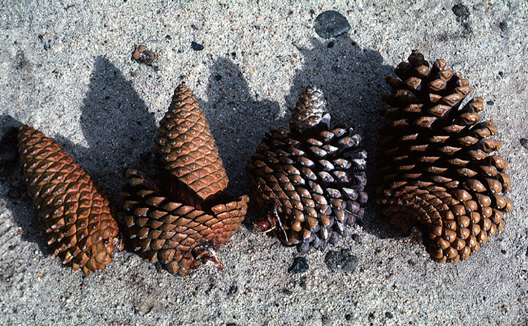
maturity
Ovulate (female) cones of Pinus sp.

Slide 64
Fertilization
As mentioned above, pollination is the transfer of pollen to the female cone, and is not the same as fertilization. After a pollen grain enters the micropyle and contacts the nucellus of the female plant, as mentioned, a tube from the pollen grain begins to grow through the nucellus. The nucleus of the tube cell remains near the tip of this tube, apparently directing its growth. Within the pollen, the generative cell divides to form a stalk cell and a body cell. The nucleus of the body cell divides once more to form two sperm nuclei. When the pollen tube penetrates the egg, the sperm nuclei travel down the pollen tube, then enter the egg. One of them unites with the egg nucleus (fertilization) and the other disintegrates. Even though several archegonia are formed, only one egg is fertilized and only one zygote develops per ovule. The other sperm nucleus and all other eggs and archegonia in that female gametophyte disintegrate so one zygote per ovule is left.

Slide 65
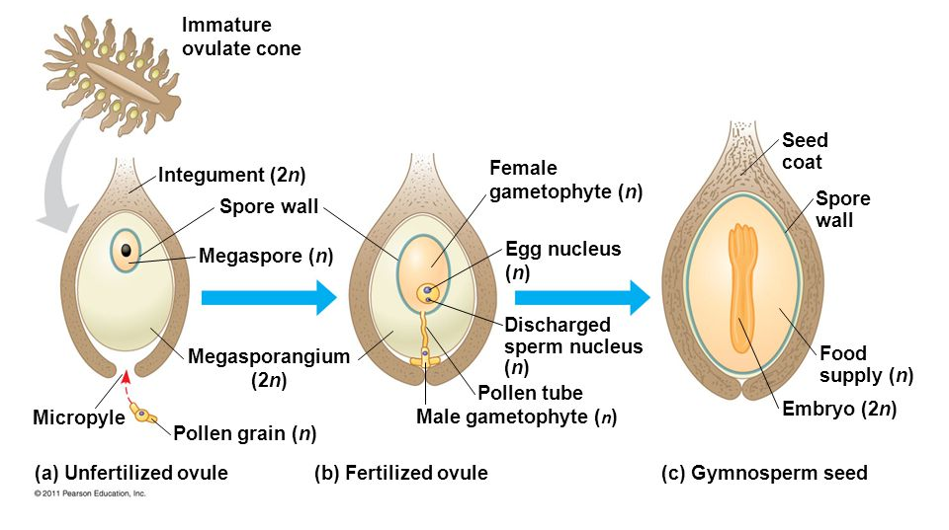

Slide 66
New Sporophyte and Seed
As the cells of the new zygote divide, an embryo sporophyte (2n) is formed in the midst of the female gametophyte (1n). The female gametophyte (1n) stores up “food”, especially oils and proteins, for the embryo to use until it sprouts and begins to do photosynthesis. The nucellus (2n) becomes a thin, papery layer and the integument (2n) becomes a hard seed coat. A portion of the scale (2n) separates from the scale to form a “wing” for the seed.
The embryo within the female gametophyte has definite parts, visible in a cross section of the seed. The central axis of the embryo is called the hypocotyl because it is located below the cotyledons. The bottom end (near the micropyle) is called the radicle (radix = root) and will become the root. At the opposite (top) end is a cluster of finger-like “leaves” called cotyledons. In the center of them is a mound of tissue called the epicotyl which, technically is above them, and will become the new stem (trunk) and leaves (needles).

Slide 67
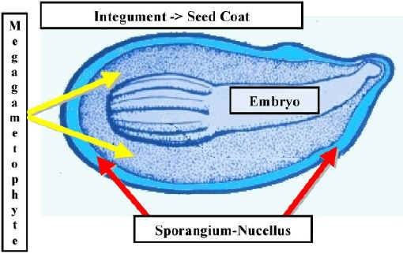
Mature seed structure

Slide 68
Pinaceae – Seed Adaptations
The seed has many obvious functional adaptations
Has winged appendage to aid wind dispersal (developed from lining of ovuliferous scale).
The seed is nutritive and is eaten by animals who act as dispersal agents.
The strong seed coat allows seeds to be dispersed by abiotic agents without damage.
The seed coat prevents the entry of pathogens and protects it from physical damage.

Slide 69
Pinaceae – Seed Adaptations
The seed contains a mature embryo which is ready to germinate (endosporic development).
  Polycotyledonous: 2-18
  Maturing in 2-3 yrs
  The megagametophyte is a readily available food source to the embryo during germination.
The seed is viable for long periods in the soil. Thus, its germination can be stretched over many years or can be triggered by specific environmental stimuli, like heat.

Slide 70
Pinaceae - Germination
Germiation is epigeal
The first sign of germination is the fracturing of the seed coat and the emergence of the Radicle
The hypocotyl elongates and lifts the remainder of the seed above the substrate.
The cotyledons enlarge and absorb nutrients from female gametophyte (now endosperm), further growth of the cotyledons results in their separation from the megagametophyte.
The cotyledons complete their development and act as photosynthetic leaves.

Slide 71
Pinaceae - Germination
The embryonic shoot (Epicotyl) emerges and produces the first leafy stem.
This overtakes the cotyledons as the source of photosynthate.

Slide 72
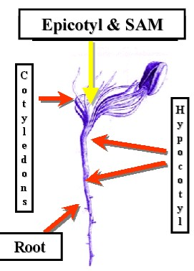
Germination
in the
conifer
seed

Slide 73
Coniferaceae / Pinaceae - Examples
Pinus (Pines)
Picea (Spruce)
Cedrus (Cedars – not WI cedar)
Abies (Firs)

Slide 74
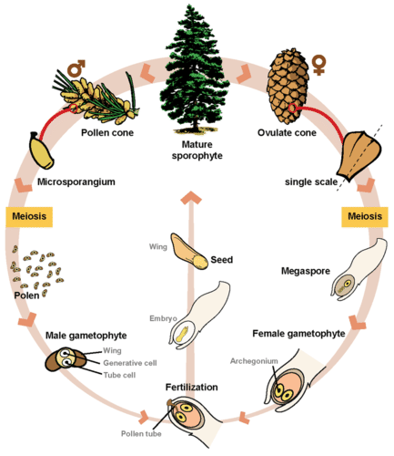

Slide 75
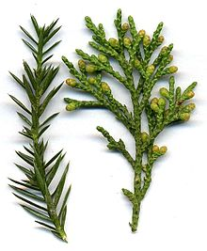
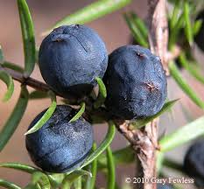
Family Cupressaceae – Cypress family
Cypress family. These are mostly evergreen trees or shrubs with small, scaly leaves and separate male and female cones, sometimes on separate trees. The seed cones are typically woody or leathery, with one to several seeds behind each scale. The juniper "berry" is really a cone with merged, fleshy scales.

Slide 76
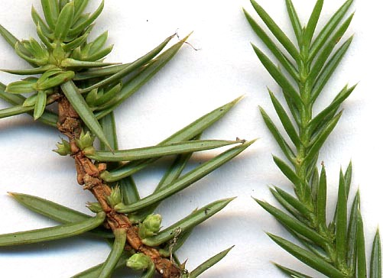
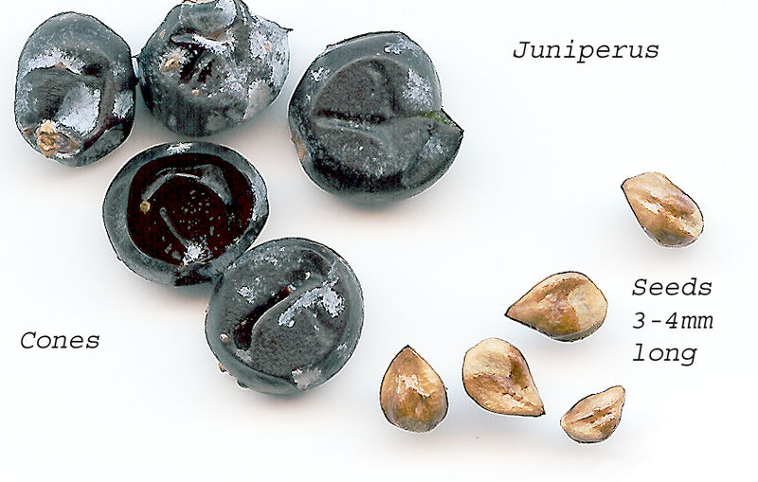
  Division Coniferophyta - Conifers
Class Pinopsida
Order Pinales
Family Cupressaceae – Cypress family
Juniperus sp. - Juniper
needle-like leaves
berry-like cones and seeds

Slide 77
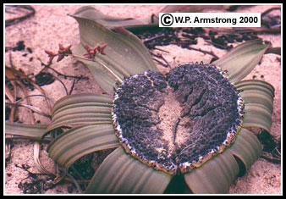

Division Gnetophyta
This group has three orders Ephedrales, Gnetales, and Welwitschiales, each with one living genus, Ephedra, Gnetum, and Welwitschia, respectively. There are 65 species in the genus Ephedra, 30 or more in Gnetum, but only one in Welwitschia.
Welwitschia
Gnetum

Slide 78


Orders Ephedrales
Ephedra - drought-resistant shrubs with jointed stems and whorls of minute scale-like leaves in 2's or 3's at each joint (node). It continues to be used as a medicinal tea. Species of Ephedra have double fertilization, where two sperm are involved in the fertilization. process.

Slide 79

Stem: Stem and branches are slender and green in colour. It has longitudinal ridges and furrows. The ridges and furrows of the successive internodes alternate with each other.
Leaves: The leaves are scale like. They are opposite and arranged in pairs. The leaves of each pair are joined with each other at their bases. It forms a small sheath around the stem.

Slide 80


Male strobili develop in the axil of scaly leaves on the nodes. Each strobilus is round or ovoid in shape. On the strobilus axis are arranged 2 to 12 pairs of bracts in opposite decussate manner. All the bracts are fertile except a few on the lower side. Each male flower consists of two bracteoles and a stamen. A single staminate flower arises in the axil of each bract. Each stamen is a stalked structure with 2 to 4 anthers or microsporangia at the top.
A compound male strobilus
A single male flower of Ephedra

Slide 81


Female Strobilus:
Similar to the male strobilus, the female strobilus also develops in the axil of the leaf on the node. It is sessile and smaller than male strobilus. Two to four pairs of bracts are arranged in opposite decussate manner on the strobilus axis. Except the uppermost pair of bracts, all are sterile. Two ovules are present in the axil of uppermost pair of bracts, out of which generally only one ovule survives.
A single female spike
Part of female plant

Slide 82


Division Gnetophyta
Class Gnetopsida
Order Ephedrales
Family Ephedraceae – Mormon-tea family
Ephedra – jointfir
Shoot of Ephedra

Slide 83

Female strobilus
C
A- ovulate shoots, B - female strobilus, C – L.S. of the top ovulate strobilus

Slide 84

Division Ginkgophyta
Class Ginkgopsida
Order Ginkgoales
Family Ginkgoaceae
Ginkgo biloba
A ginkgo tree is pyramidal in shape, with a columnar, sparingly branched trunk up to 30 metres tall and 2.5 metres in diameter. Fan-shaped ginkgo leaves resemble the leaflets of the maidenhair fern and are borne on short, spurlike but greatly thickened shoots. The leathery leaves are up to 8 cm long and are sometimes twice as broad.
Leaf of ginkgo

Slide 85
Two parallel veins enter each blade from the point of attachment of the long leafstalk and fork repeatedly toward the leaf edges. Most leaves are divided into two lobes by a central notch.
Microsporangia (pollen-forming structures) and female ovules are borne on separate trees. Pollen grains are carried to the female trees by the wind.
Megasporangiate trees bear paired ovules, which, when fertilized, develop into yellowish, plumlike seeds about 2.5 cm long, consisting of a large inner nutlike portion surrounded by a fleshy outer covering. The “nut” is silvery in colour (the word ginkgo is derived from the Chinese and Japanese words for silver nut or silver apricot) and when roasted is considered a delicacy. The ripened fleshy covering has a very disagreeable odour, similar to that of rancid butter, making the female tree less popular for garden planting.

Slide 86



Cycas sp.
Cycas. A single leaf.

Slide 87
Cycas, a genus of 105 species of palmlike tropical and subtropical ornamental cycads (family Cycadaceae), among them trees 12 metres or more in height. Their leaves are dark green and circinate (uncoiling as fern leaves do), differing from those of other members of the family in having a midrib but no lateral veins. The seeds are borne along the margins of modified leaves, which are arranged in a whorl at the top of the trunk, rather than in compact cones. The leaves of Cycas revoluta, sometimes called the sago palm, are widely used as ceremonial “palms” and in floriculture (see photograph); the pithy stems of this and other species are a source of sago, a food starch.

